Slide 1
EDA PROJECT The Analysis of Housing prices in Nigeria to determine the most influential factors
Presented by Group 1 (DS Cohort 6)
Kemi Awogboro
Arit Peter
Akinola Olusegun
Joyce Longtang Daser- ADAMS
Data Source:
https://www.kaggle.com/datasets/abdullahiyunus/nigeria-houses-and-prices-dataset
EXECUTIVE SUMMARY
This project aims to answer the question of how some variables affects house prices in 25 states of Nigeria, what is the correlation existing between these variables and the house prices, to identify the highest and lowest cost of house based on type and location and lastly to identify any outliers.
This dataset contains Houses listings in Nigeria and their prices based on Location and other parameters with a data shape of 24326 rows and 8 columns.
This project was summarized using different graphical and data visualizing tools such as plots, pie chart, barchart.

Slide 2
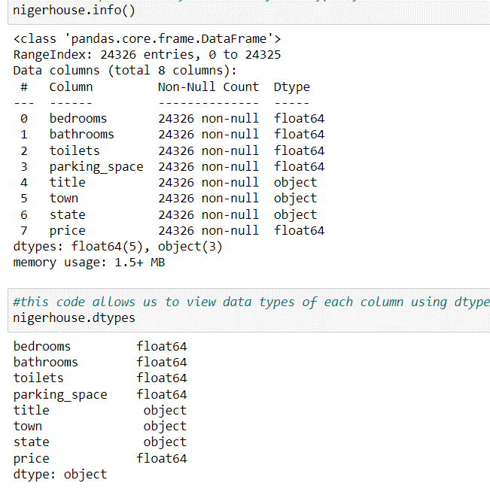

Slide 3
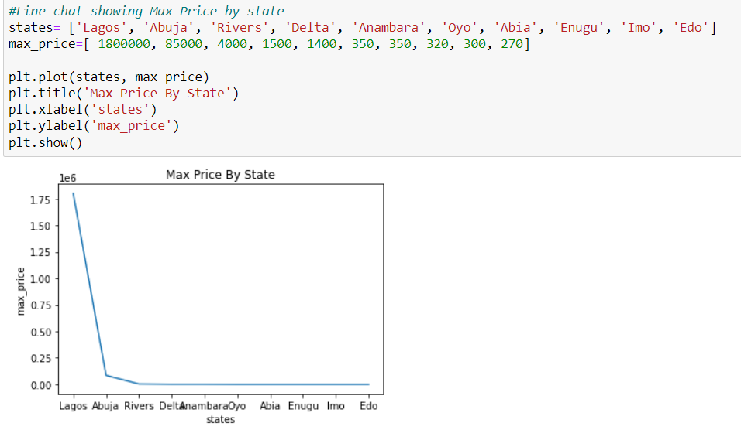
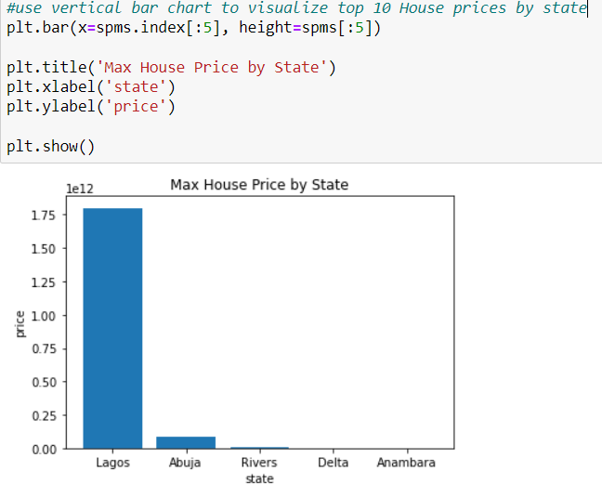
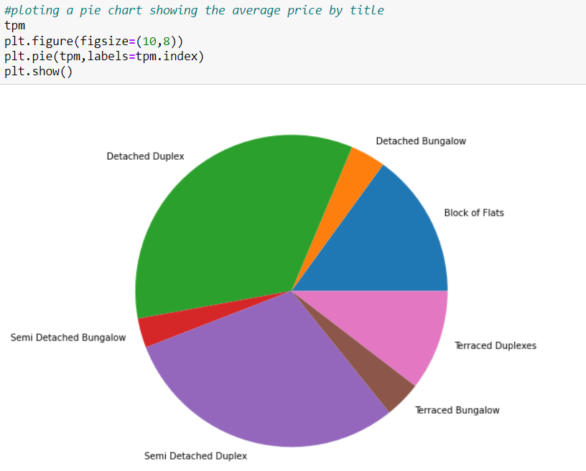
Price is mainly determined by location

Slide 4
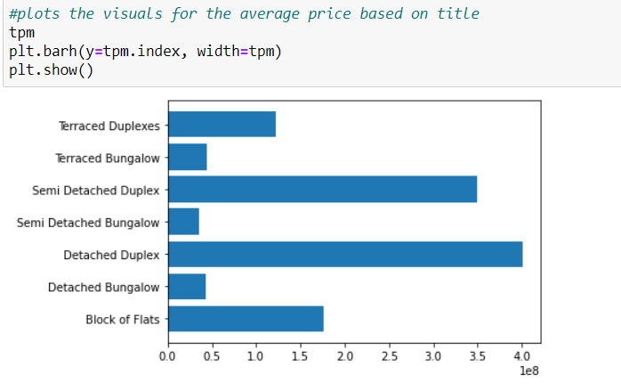
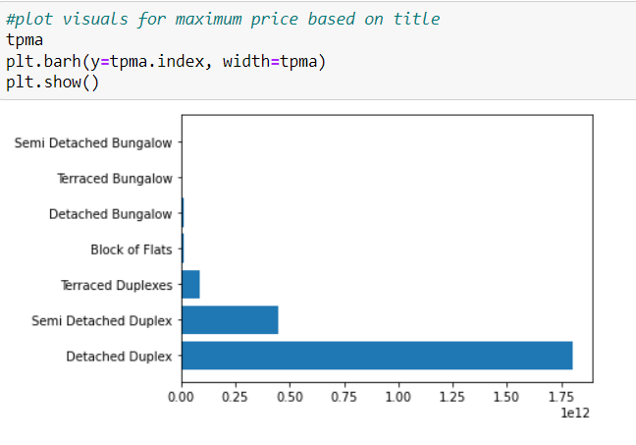
Relationship exist between type of house and price

Slide 5
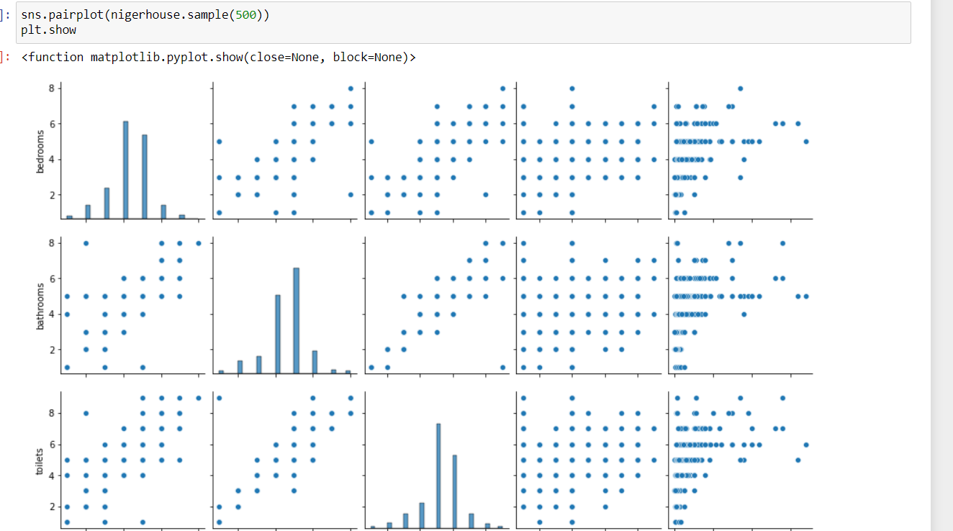
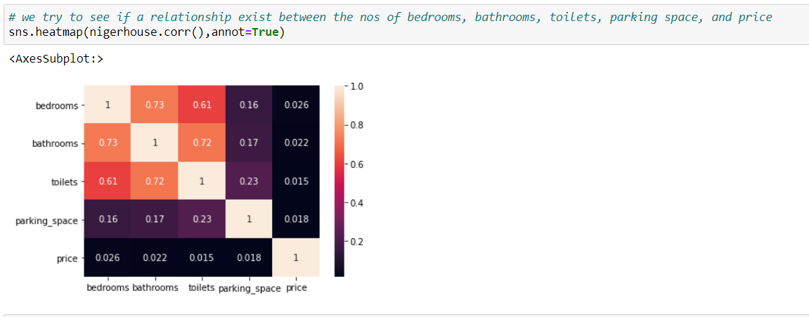
No Strong correlation exist between bedrooms, Bathroom, parking space , toilet and price

